Slide 2
MOVEMENTS OF EARTH

Slide 3
ROTATION

Slide 4
Movements of Earth /Social/N Karunambigai//SNS ACADEMY

Slide 6
REVOLUTION

Slide 7
Movements of Earth/Karunambigai/Social/SNS ACADEMY

Slide 9
SEASONS

Slide 11
SEASONS
Movements of Earth/Social/NKarunambigai/SNS ACADEMY

Slide 12
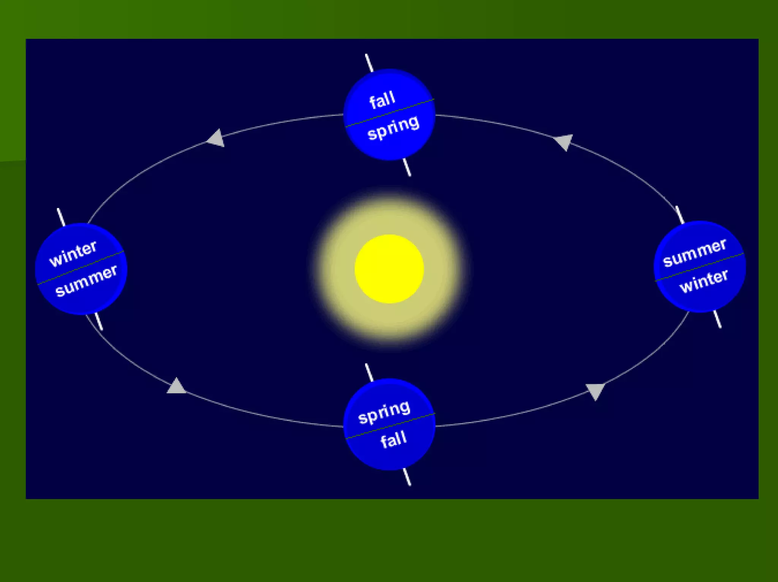
Movements of Earth/Social/NKarunambigai/SNS ACADEMY

Slide 13
MOVEMENTS OF EARTH
https://youtu.be/wYWgvkwCf8o

Slide 14
SEASONS

Slide 15
SUMMER

Slide 16
WINTER

Slide 17
SPRING
Movements of Earth/Social/NKarunambigai/SNS ACADEMY

Slide 18
AUTUMN

